Slide 1
CSE-428 Presentation
Group - 1
Name 1 : Md. Moynul Asik Moni (ID: 19101189)
Name 2 : Rahat Khan(ID: 20101212)
Name 3 : Maidul Islam (ID: 20101309)
Name 4 : Farjana Alam (ID: 20101022)
Name 5 : Arnob Deb (ID: 20101104)

Slide 2
1. What is the size of your dataset? Is there a separate batch for train, test, and validation, or do you need to do it manually? What are the different classes in your dataset?
The size of our dataset: (2400, 12289)
b. Here separate batch for train, test but no batch for validation. We have to do it manually for validation only.
c. Total five class : ['bear', 'boa-constrictor', 'bullfrog', 'golden-retriever', 'goldfish']
[Unfortunately there’s some NaN values in target column both in train and test batch. We removed them later before fitting the model]

Slide 3
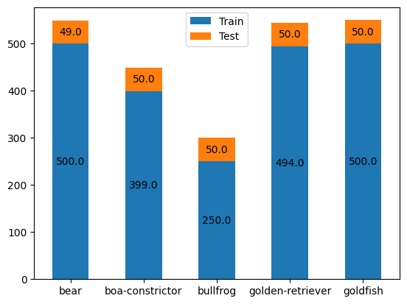
2. What is the distribution of your dataset. The number of samples per class? Show it using a plot. Is the distribution balanced or unbalanced?
Dataset distribution total (test+train): {'bear': 549, 'boa-constrictor': 449, 'bullfrog': 300, 'golden-retriever': 544, 'goldfish': 178}
The distribution is unbalanced

Slide 4
3. If a dataset is unbalanced, what kind of issues we might face? What are the available techniques to tackle these issues.
If dataset is imbalanced then its hard to solve classification type problem because imbalanced data can hamper the model accuracy in a large scale. If the distribution of dataset is not balanced and there is a high number of data in some particular classes comparing to others, the dataset is considered to be biased towards those classes. While training the model, the model will also be biased if we use the same dataset. Here the model will train and predict well for classes with high volume but the model won’t train and predict well and loss will be higher for classes with low volume.
We can use Resampling Techniques (over sampling , under sampling) and data augmentation to handle these issues.

Slide 5
4. Which technique are you going to use to tackle your unbalanced dataset and why?
We are going to use data augmentation. Datasets that are created through data augmentation are useful because they can improve the predictive accuracy and general performance of machine learning models by reducing the risk of overfitting—where models catch inaccurate values present in a dataset.

Slide 6
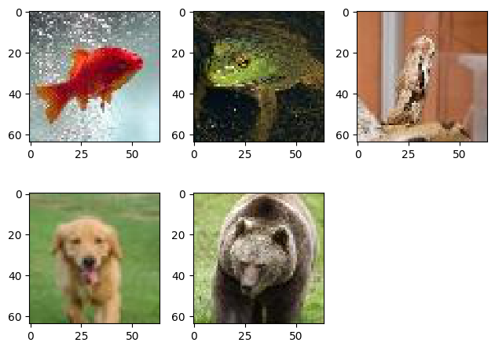
5. Review some sample images from the dataset carefully. What are the sizes of the images? Are the images coloured or black and white? Can you do any kind of pre-processing (including but not limited to average filtering, unblur filtering, frequency domain filtering, CLAHE, etc) that might possibly help the classifier? If yes, please explain your rationale. NOTE: you DO NOT need to perform these pre-processing for Milestone 1.
a .Reviewing some sample images from the dataset
a . Sizes of the images are (64, 64, 3)
b . The images are coloured.
c . In general
Contrast limited adaptive histogram equalization (CLAHE) for improved visibility level of foggy image.
Contrast adjustment for dark image,
Converting the image into a grayscale image.
Scaling, suppressing background noise, highlighting the target area of the image and eliminating noise.
Usage of unblur filter for blurry image
But for our case no preprocessing is required as images are quite adjusted.

Slide 7
6. How can we interpret these results?
Accuracy: Model accuracy is defined as the number of classifications a model correctly predicts divided by the total number of predictions made.
Sensitivity: Sensitivity is a measure of how well a machine learning model can detect positive instances
Specificity: Specificity itself can be described as the algorithm/model's ability to predict a true negative of each category available.
Positive predictive value: The positive predictive value is defined as the proportion of predicted positives which are actual positives.
Negative predictive value: The negative predictive value is defined as the proportion of predicted negatives which are real negatives.
Confusion matrix: A confusion matrix is a summary of prediction results on a classification problem
F1 score: The F1 score is defined as the harmonic mean of precision and recall

Slide 8

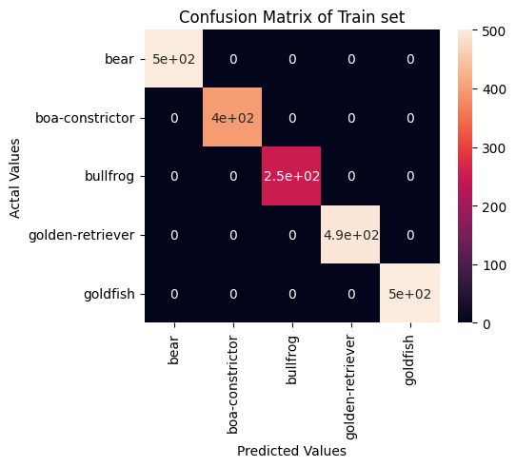
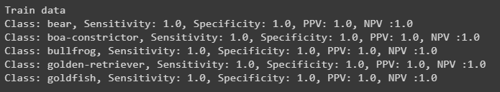
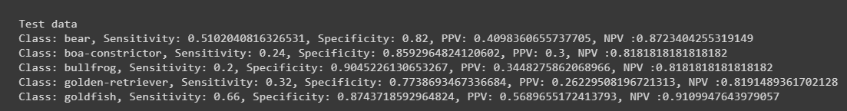
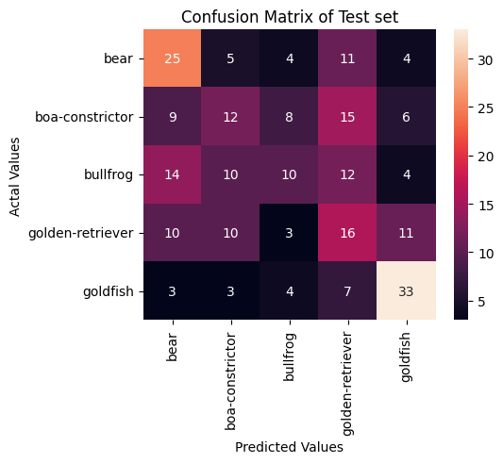
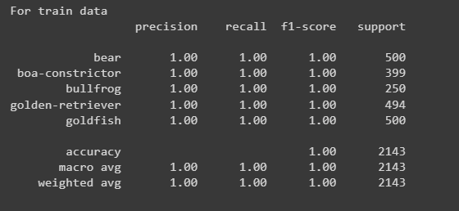
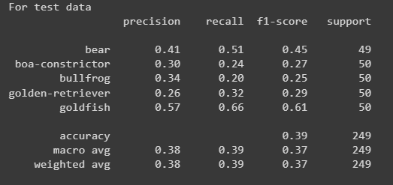

Slide 9
Thank You

